Slide 1
Development and Implementation of Innovation and Entrepreneurship Project Management System for College Students
By Wang Yali
1911042-Hinal Pujara RDBMS-IA1

Slide 2
I. Introduction
Information Technology in University Teaching.
This paper applies employment content and specific handling to direct system design and use reasonable & complete scheme to solve low- efficiency problems.
B/S data framework, OOPS concepts in JAVA programming, data storage through MSSQL2015 and J2EE framework application.
This paper also explores Structure, Science, Data share and Probability.

Slide 3
II. Demand Analysis of System
System Implementation Scheme
Requirement Analysis of Affairs
Non-functional Requirements in System

Slide 4
A. System Implementation Scheme
Development of courses and increase in quantity led to improved teaching quality.
Standardise and Systematic
Scientific and reasonable confirmation
University actively studying and discussing supporting measures for mentor’s workload.

Slide 5
B. Requirement Analysis of Affairs
Divide system into several modules:
Project management system
Achievement management
Supervisor answering management
Project information management
System management

Slide 6
C. Non-functional Requirements in System
Non-functional requirements of this system includes:
User’s operating requirements
System security requirement
Maintainable
Interface requirement

Slide 7
III. System Design
General Hierarchical Structure Design
Class Diagram
Database Design

Slide 8
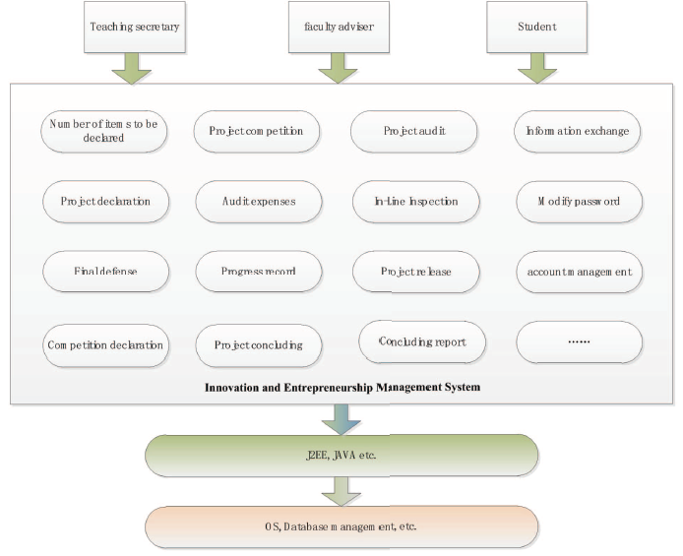
A. General Hierarchical Structure Design
Adopts B/S and performed design realization from functional modules.
Teaching secretaries complete 15 functional modules.
Instructing teacher user include 8 functional modules.
Student users include 12 functional modules
The first layer is software infrastructure
The second layer is secondary development.
The third layer considers different user’s requirements

Slide 9
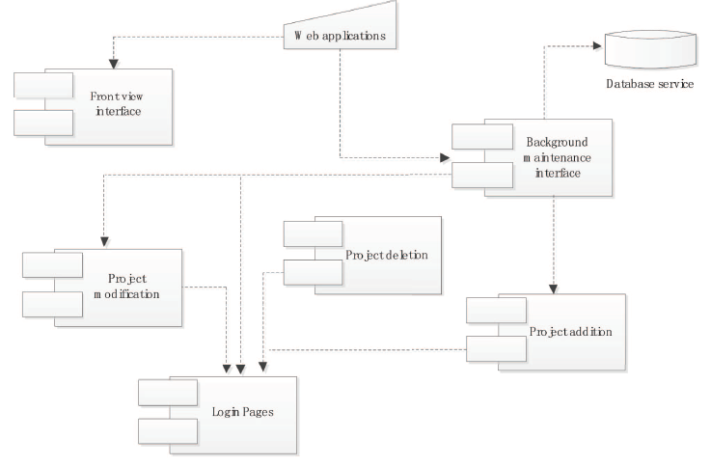
The component figure mainly has 3 layer-task:
Data access layer
Logic processing layer and
Expressing layer
Web application contain components – foreground sub-system, background sub-system and packet components.

Slide 10
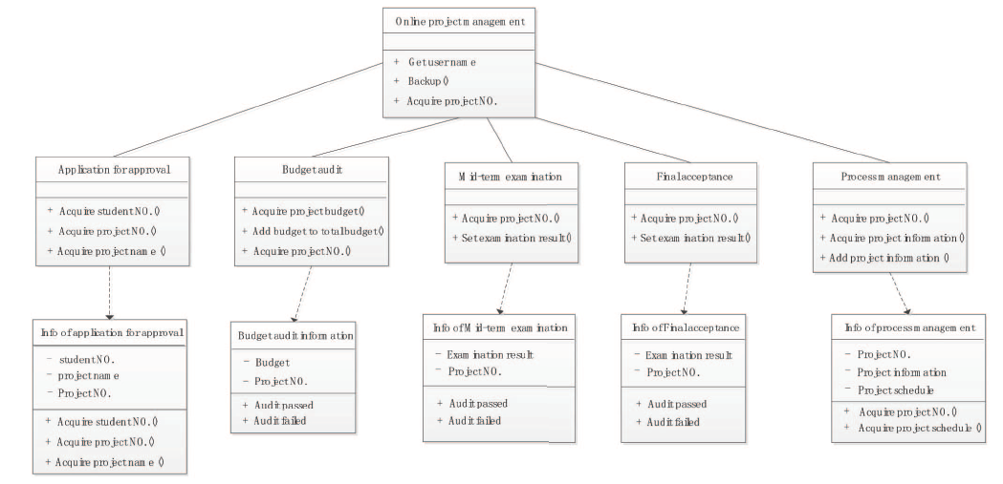
B. Class Diagram

Slide 11
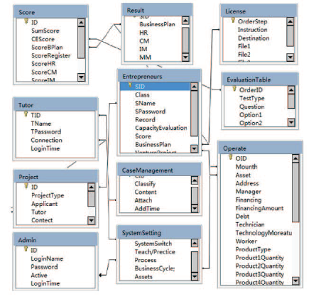
C. Database Design
Define database mode - input data - operate data
Complete restriction condition - referring - security mechanism - backup mechanism
The tables are user, admin, project, achievement , etc

Slide 12
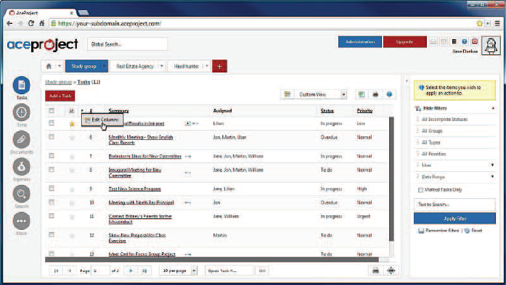
IV. System Realization and Application
Student Login Interface

Slide 13
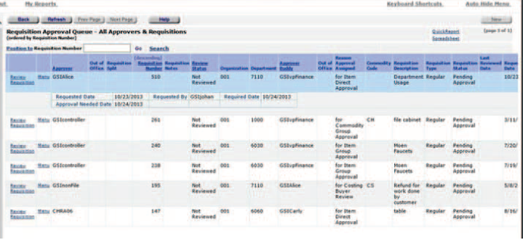
User interface of process management of project application

Slide 14
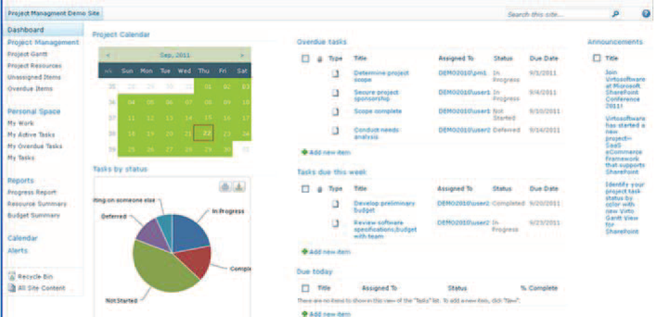
Main interface of guide teacher function

Slide 15
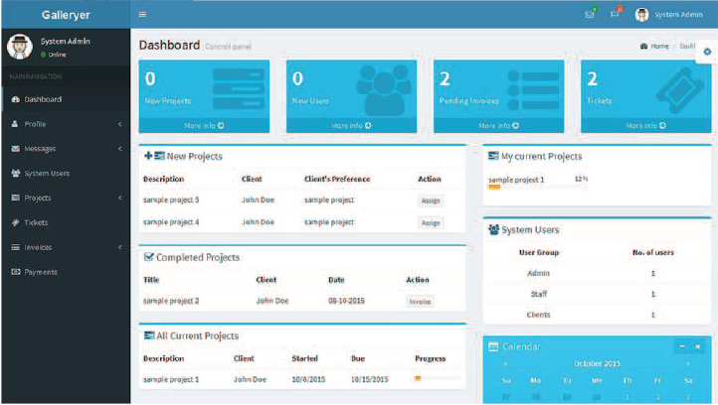
Project interface of management and audit

Slide 16
V. Conclusion
Adopts J2EE development platform, JAVA programming, B/S structure integrates quality and process of employment, design and analysis.
During analysis and design software engineering rules will be strictly operated.
Adopts module function division and modalized design idea.
System can be easy to expand if it satisfy development requirements.

Slide 17
References
Salwen P. Fostering Innovation and Entrepreneurialism in a Value-Driven Organization. Leadership & Management in Engineering, 2003, 3(3):153-158
Xu J, Houssin R, Caillaud E, et al. Fostering continuous innovation in design with an integrated knowledge management approach. Computers in Industry, 2012, 62(4):423-436
Bielenia-Grajewska M, Carayannis E G, Campbell D F J. Linguistic Dimension of Creativity, Invention, Innovation, and Entrepreneurship. Encyclopedia of Creativity Invention Innovation & Entrepreneurship, 2013, 7(1):77–78
Zhang wen, wu zongxi.Journal of power science and technology,2015,30(4):71-77
Edwards-Schachter Barrio Luengo M, Interrelationships M, et on García-Granero A Sanchez Disentangling competences: creativity, innovation and al. entrepreneurship. Thinking Skills & Creativity, 2015, 16:27 39
Miles I D. Cultures and Innovation. Journal of Nuclear Cardiology, 2011, 16(5-6):1-3

Slide 18
Implementation Strategy
Databases will be according to the design given. It will include all the tables given using. Frontend would be created using HTML and CSS

